Slide 1

Module 1
Introduction to OS

Slide 2
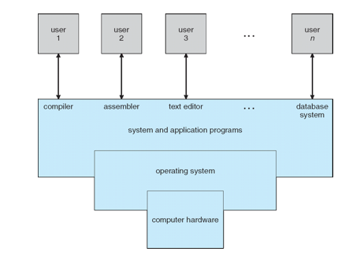
What is an Operating System?
A program that acts as an intermediary between a user of a computer and the computer hardware
Operating system goals:
Execute user programs and make solving user problems easier
Make the computer system convenient to use
Use the computer hardware in an efficient manner
Source: “Operating System Concepts: 9th Edition” by Silberschatz Galvin Gagne

Slide 3





Introduction to OS
Operating System(OS) manages computer hardware.
Application Program runs on OS
Computer User interacts with the OS which in turn interacts with the hardware.
Variety of OS depending on the tasks. Example:-
Mainframe OS
Optimize hardware utilization
Computer standard OS
Standard Application, Games, etc.
Handheld OS -> Apps, etc.

Slide 4

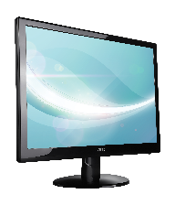
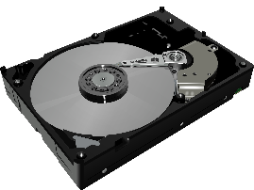
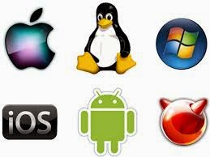
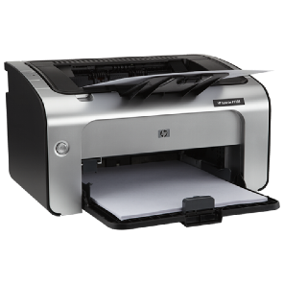
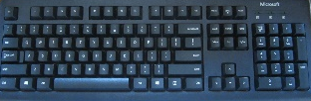
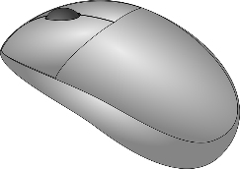

Slide 5
OS as a base for Application Programs
OS is a resource allocator
Manages all resources
Decides between conflicting requests for efficient and fair resource use
OS is a control program
Controls execution of programs to prevent errors and improper use of the computer
Application program runs on a platform and that platform is an Operating systems.
OS plays an important role to determine which application you need, because some applications may exists only in some OS.
Example:
Words in windows
Libre office in linux

Slide 6
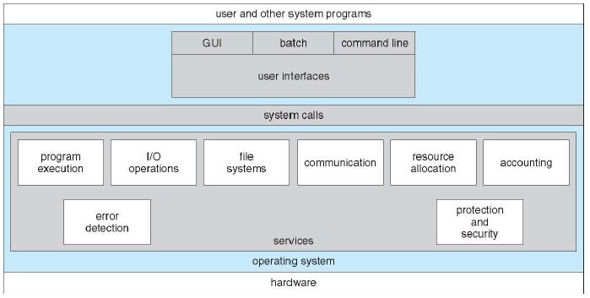
Schematic of Operating System Operations
Silberschatz, Gagne, Galvin: Operating System Concepts, 6th Edition

Slide 7
OS Services
User Interface: There are different kinds, like touchscreen, GUI, and command-line.
Program Execution: (Execute programs for users)
I/O operations: It is much too difficult for users to operate the I/O hardware correctly without help.
File System Manipulation: The OS helps us store, organize, manage, and protect our information.
Communications: Users need their processes to exchange information. OSs help. The two main ways to do it are with shared memory and by message passing.
Error Detection: An OS continually checks to see if something is going wrong. The OS is programmed to take appropriate action.
Resource Allocation
Logging:
Records for accounting, fault detection, failure, protection, maintenance, update, security, etc.
Protection and Security.

Slide 8
Different types of OS
Microsoft Windows
Mainframe
DOS
OS/2
Linux - Example Ubuntu
Mac OS
AmigaOS

Slide 9
Design Goals
Design Goals:
system that is convenient,
reliable,
safe, and
fast.
Implementation: The implementation of the operating system, that is the manner in which the ideas of the design are written in programming language(s).
Assembly
High Level Language
Earlier assembly could make the code run faster but nowadays high-level are translated to equivalently good assembly code.
Instead performance of OS will increase if selection data structure and algorithms are done rather than proper assembly code.

Slide 10
OS Design Issues
Efficiency – amount of useful work wrt the time and resources
Robustness – prolonged working hours without crashing
Flexibility – ease of modification of components
Portability – ability to run a program in different platforms
Security – secure systems – authentication and authorization
Compatibility – software runs on different models of the family.

Slide 11
Operating System Structures
Simple
Monolithic
Micro-kernel models
Layered (conceptual)
Modular
Kernels may be classified mainly in three categories: -
Monolithic Kernel
Micro Kernel
Hybrid Kernel

Slide 12
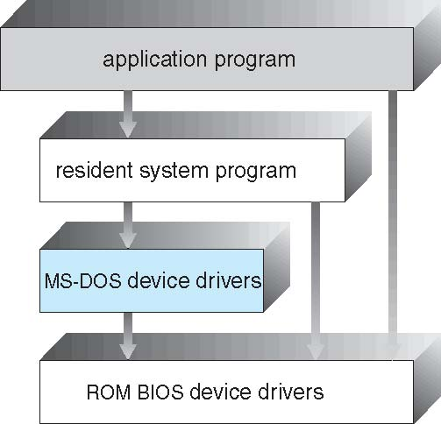
Simple
Advantages of Simple structure:
It delivers better application performance because of the few interfaces between the application program and the hardware.
Easy for kernel developers to develop such an operating system.
Disadvantages of Simple structure:
The structure is very complicated as no clear boundaries exists between modules.
It does not enforce data hiding in the operating system.

Slide 13
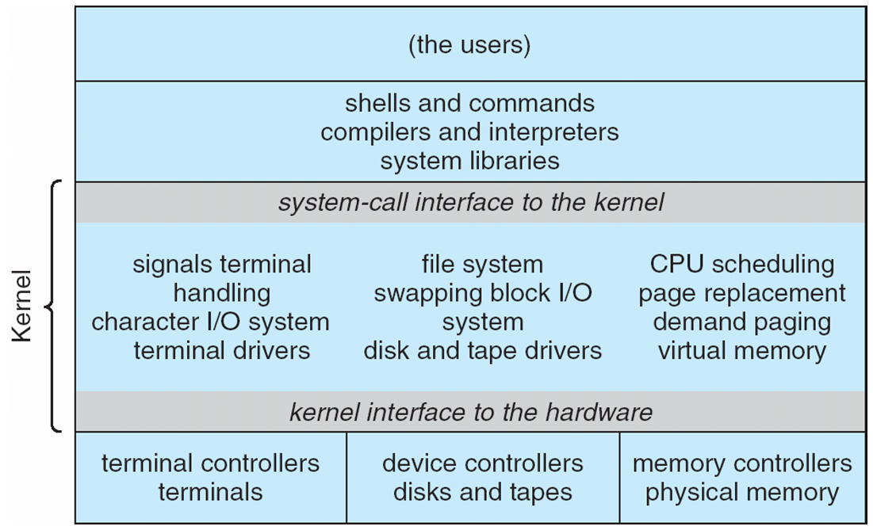
Monolithic
Monolithic Kernel
value on speed and efficiency.
Monolithic is a single static binary file.
It executes in a single address space.
Silberschatz, Gagne, Galvin: Operating System Concepts, 6th Edition

Slide 14
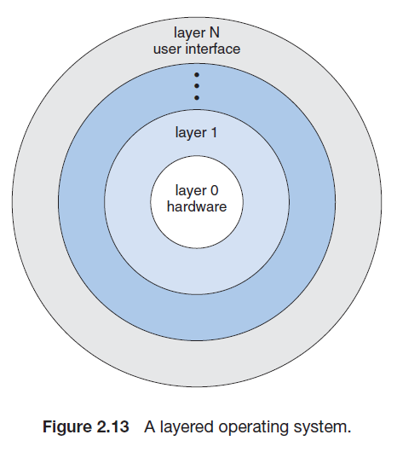
Layered
Division into number of layers as shown in figure.
Innermost layer is hardware
Outermost layer is interface
Advantages of Layered structure:
Layering makes it easier to enhance the operating system as implementation of a layer can be changed easily without affecting the other layers.
It is very easy to perform debugging and system verification.
Disadvantages of Layered structure:
In this structure the application performance is degraded as compared to simple structure.
It requires careful planning for designing the layers as higher layers use the functionalities of only the lower layers.
Silberschatz, Gagne, Galvin: Operating System Concepts, 6th Edition

Slide 15
Microkernels:
Keep only necessary component in kernel. Others are implemented as programs (system or user level).
Resulting in a kernel smaller in size.
Minimal process management
Minimal memory management
Main role is that it facilitates communication between the client program and the various services that are running in user space.
Mach example of microkernel
Mac OS X kernel (Darwin) partly based on Mach
Communication takes place between user modules using message passing
Benefits:
Easier to extend a microkernel
Easier to port the operating system to new architectures
More reliable (less code is running in kernel mode)
More secure
Detriments:
Performance overhead of user space to kernel space communication

Slide 17
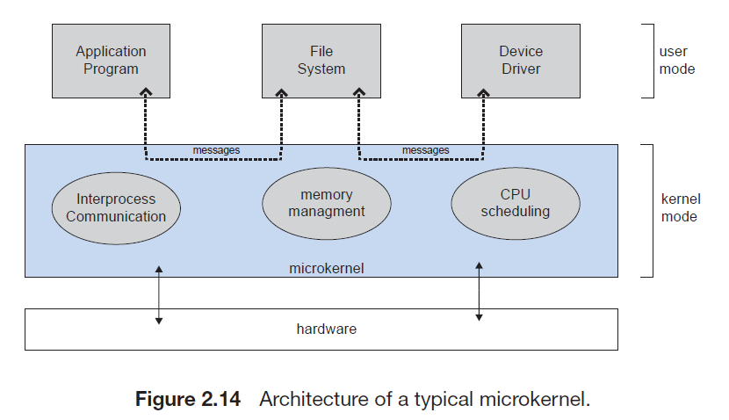
Microkernel
Silberschatz, Gagne, Galvin: Operating System Concepts, 6th Edition

Slide 18
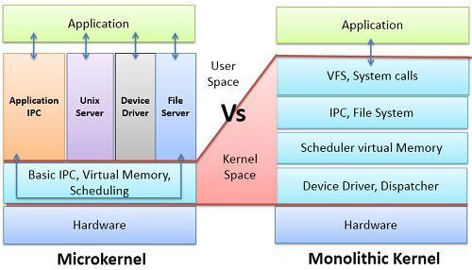
Monolithic vs Microkernel
Source: www.atg.world/Monolithic vs Microkernel

Slide 19
BASIS FOR COMPARISON | MICROKERNEL | MONOLITHIC KERNEL
Basic | In microkernel user services and kernel, services are kept in separate address space. | In monolithic kernel, both user services and kernel services are kept in the same address space.
Size | Microkernel are smaller in size. | Monolithic kernel is larger than microkernel.
Execution | Slow execution. | Fast execution.
Extendible | The microkernel is easily extendible. | The monolithic kernel is hard to extend.
Security | If a service crashes, it does effect on working of microkernel. | If a service crashes, the whole system crashes in monolithic kernel.
Code | To write a microkernel, more code is required. | To write a monolithic kernel, less code is required.
Example | QNX, Symbian, L4Linux, Singularity, K42, Mac OS X, Integrity, PikeOS, HURD, Minix, and Coyotos. | Linux, BSDs (FreeBSD, OpenBSD, NetBSD), Microsoft Windows (95,98,Me), Solaris, OS-9, AIX, HP-UX, DOS, OpenVMS, XTS-400 etc.

Slide 20
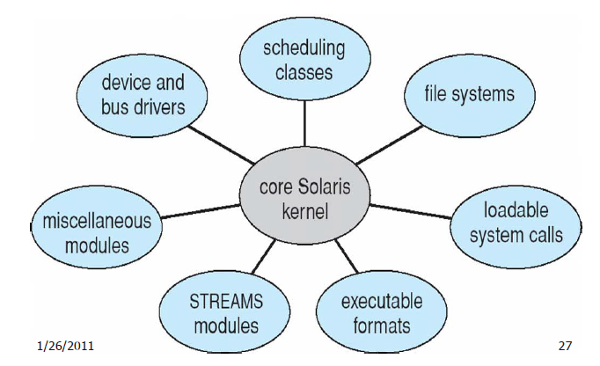
Modular
Divided into different module.
Typically employs:
dynamic loadable kernel module (LKM). i.e. Different modules communicate through kernel (core part).
LKM may be loaded during boot or when required, and can be deleted also.
An example would be a device driver support module loaded when a new device is plugged into the computer, and when the device is unplugged, the module is deleted because it is not needed any more.
Silberschatz, Gagne, Galvin: Operating System Concepts, 6th Edition

Slide 21
System Calls
Programming interface to the services provided by the OS
Typically written in a high-level language (C or C++)
Mostly accessed by programs via a high-level Application Programming Interface (API) rather than direct system call use
Three most common APIs are Win32 API for Windows, POSIX API for POSIX-based systems (including virtually all versions of UNIX, Linux, and Mac OS X), and Java API for the Java virtual machine (JVM)

Slide 22
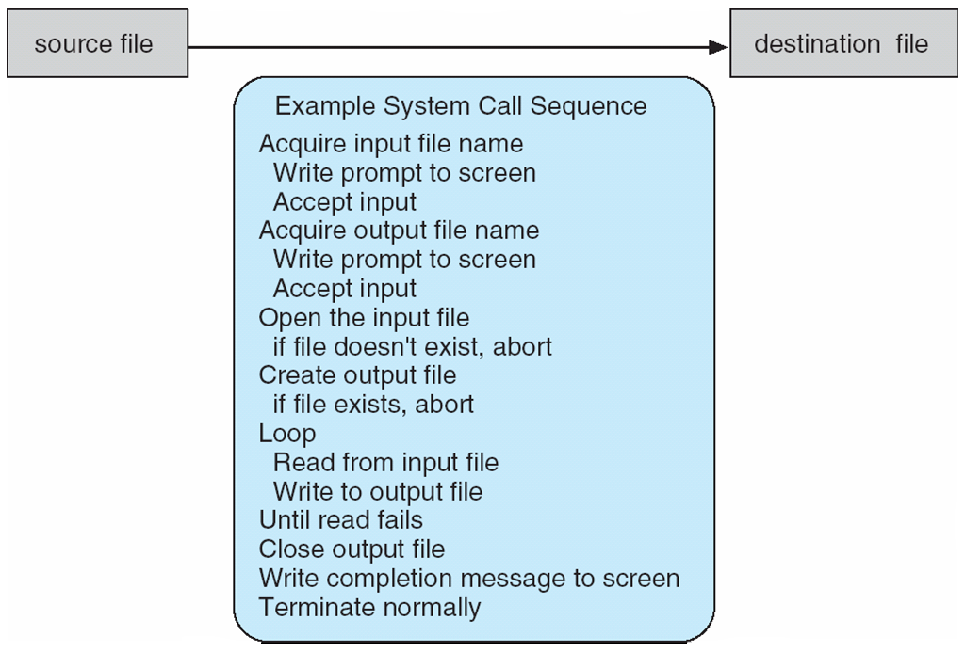
System Calls - Example
System call sequence to copy the contents of one file to another file

Slide 23
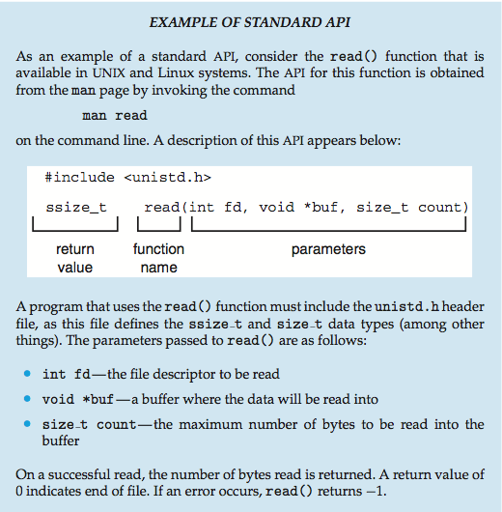
Example of a Standard API

Slide 24
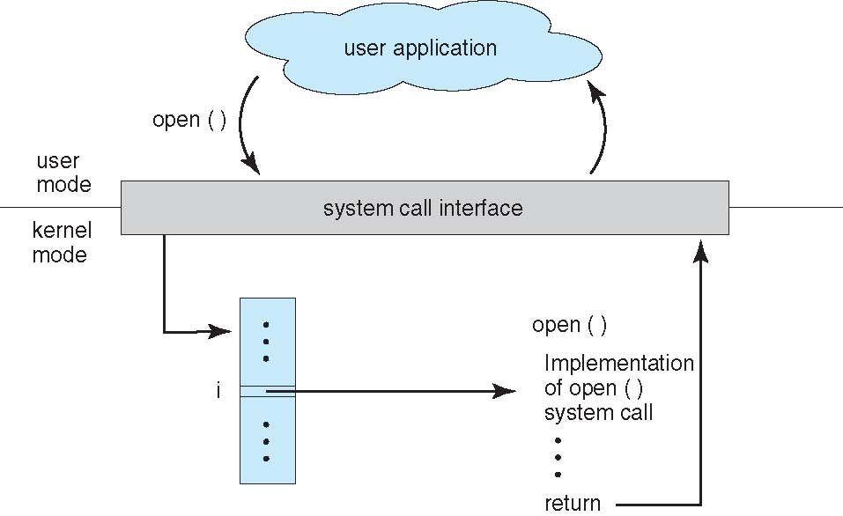
API – System Call – OS

Slide 25
System Call – Types
Process control
create process, terminate process
end, abort
load, execute
get process attributes, set process attributes
wait for time
wait event, signal event
allocate and free memory
Dump memory if error
Debugger for determining bugs, single step execution
Locks for managing access to shared data between processes

Slide 26
System Call – Types (Cont.)
File management
create file, delete file
open, close file
read, write, reposition
get and set file attributes
Device management
request device, release device
read, write, reposition
get device attributes, set device attributes
logically attach or detach devices

Slide 27
System Call – Types (Cont.)
Information maintenance
get time or date, set time or date
get system data, set system data
get and set process, file, or device attributes
Communications
create, delete communication connection
send, receive messages if message passing model to host name or process name
From client to server
Shared-memory model create and gain access to memory regions
transfer status information
attach and detach remote devices

Slide 28
System Call – Types (Cont.)
Protection
Control access to resources
Get and set permissions
Allow and deny user access

Slide 29
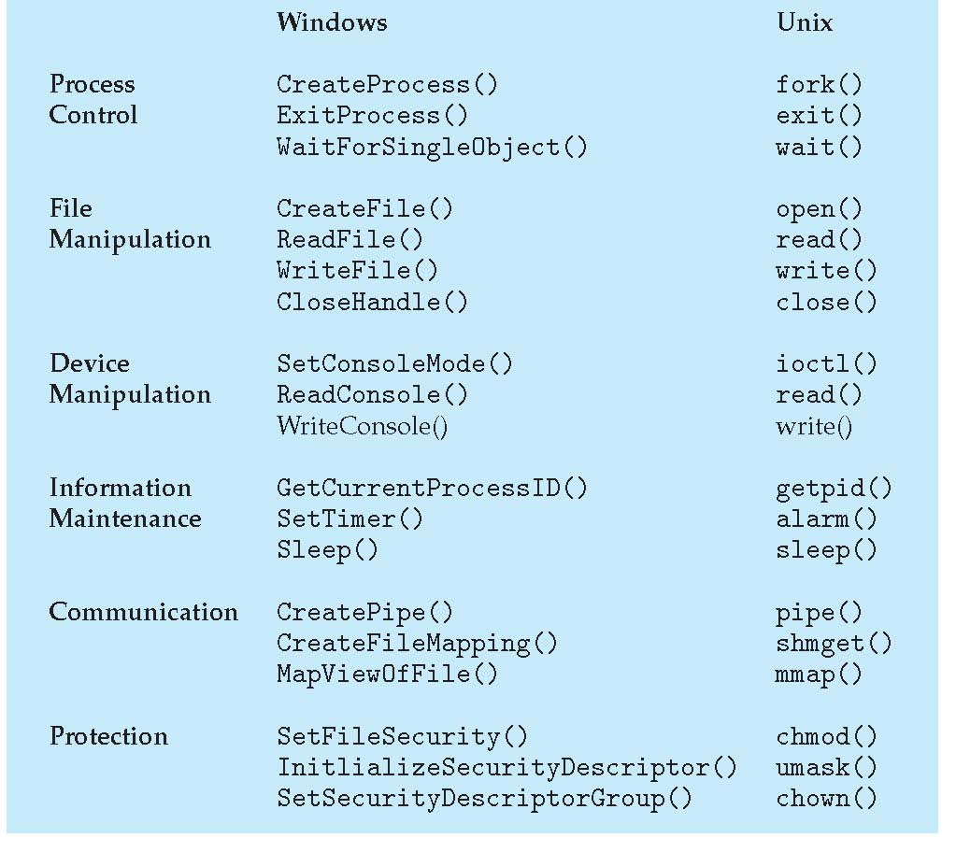
Examples of Windows and Unix System Calls

Slide 30
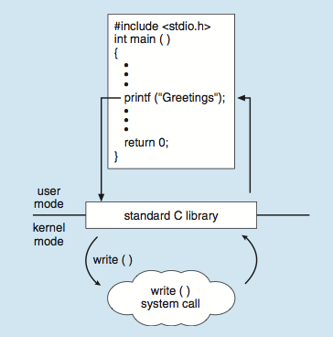
Standard C Library Example
C program invoking printf() library call, which calls write() system call

Slide 31
Protection - Modes
Dual-mode operation allows OS to protect itself and other system components
User mode and kernel mode
Mode bit provided by hardware
Provides ability to distinguish when system is running user code or kernel code
Some instructions designated as privileged, only executable in kernel mode
System call changes mode to kernel, return from call resets it to user
Increasingly CPUs support multi-mode operations
i.e. virtual machine manager (VMM) mode for guest VMs

Slide 32
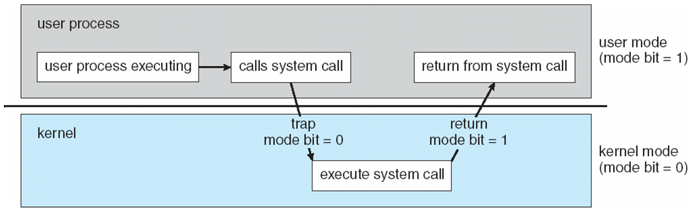
Protection – Modes (Cont.)
Timer to prevent infinite loop / process hogging resources
Timer is set to interrupt the computer after some time period
Keep a counter that is decremented by the physical clock.
Operating system set the counter (privileged instruction)
When counter zero generate an interrupt
Set up before scheduling process to regain control or terminate program that exceeds allotted time

Slide 33
Interrupt
Interrupt transfers control to the interrupt service routine generally, through the interrupt vector, which contains the addresses of all the service routines
Interrupt architecture must save the address of the interrupted instruction
A trap or exception is a software-generated interrupt caused either by an error or a user request
An operating system is interrupt driven
Interrupt driven (hardware and software)
Hardware interrupt by one of the devices
Software interrupt (exception or trap):
Software error (e.g., division by zero)
Request for operating system service
Other process problems include infinite loop, processes modifying each other or the operating system

Slide 34
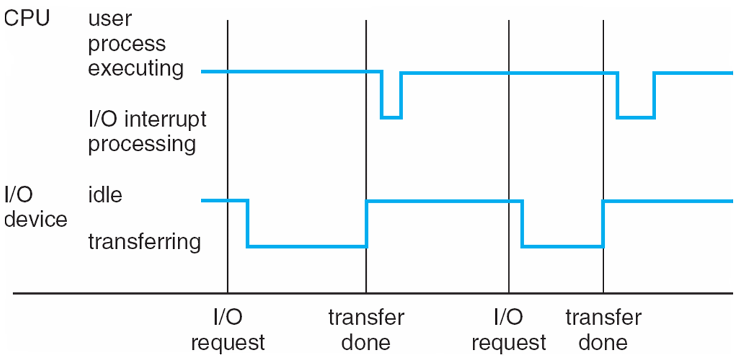
Interrupt Handling
The operating system preserves the state of the CPU by storing registers and the program counter
Determines which type of interrupt has occurred:
polling
vectored interrupt system
Separate segments of code determine what action should be taken for each type of interrupt

Slide 35
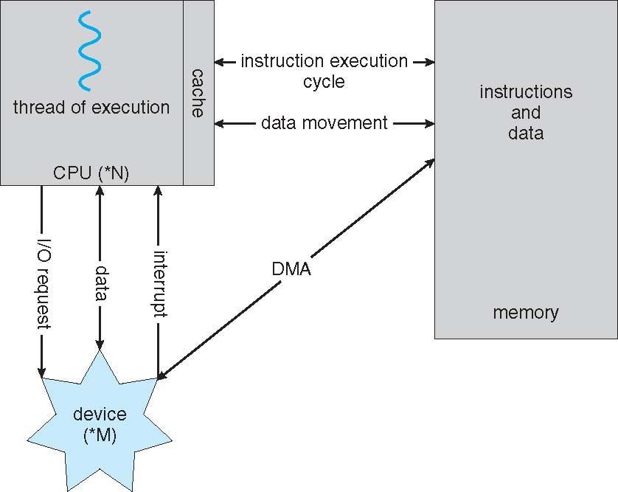
A von Neumann Architecture

Slide 36
References
Silberschatz, Gagne, Galvin: Operating System Concepts, 6th Edition
Remzi H. Arpaci-Dusseau, Andrea C. Arpaci-Dusseau - Operating Systems_ Three Easy Pieces
Ramez Elmasri, A Carrick, David Levine - Operating Systems_ A Spiral Approach (2009, McGraw-Hill Science_Engineering_Math)
https://www2.eecs.berkeley.edu/Courses/CS162/

Slide 37


